Slide 1

HUMAN AND OBJECT RECOGNITION
USING VIDEO SURVEILLANCE

Slide 2

PANIMALAR INSTITUTE OF TECHNOLOGY DEPARTMENT OF COMPUTER SCIENCE AND ENGINEERING
“HUMAN AND OBJECT RECOGNITION
USING VIDEO SURVEILLANCE"
BATCH NO. B8 DATE: 05/08/2021
Supervised By,
Mrs K.HEMA PRIYA M.Tech
Assistant Professor
Team Members,
KALLURI VENKATA DATTA SAI MANI
(211518104062)
PALAGADU CHARAN
(211518104062)
VAYUGUNDLA VENKATA SIVA DHANUSH
(211518104179)

Slide 3
ABSTRACT
Object recognition is a computer vision technique for identifying objects in images or videos. Object recognition is a key output of deep learning and machine learning algorithms. When humans look at a photograph or watch a video, we can readily spot people, objects, scenes, and visual details.To develop a system which is used to recognize different objects in each frame of the video in video surveillance system and to give an alert when some animals enter into the residential premises.Image processing is used to extract the images from video.Deep learning is used to train the system to identify a different objects and to detect the objects.Big data applications are consuming most of the space in industry and research area. Among the widespread examples of big data, the role of video streams from CCTV cameras is equally important as other sources like social media data, sensor data, agri- culture data, medical data and data evolved from space research. Surveillance videos have a major contribution in unstructured big data. CCTV cameras are implemented in all places where security having much importance. Manual surveillance seems tedious and time consuming. Security can be defined in different terms in different contexts like theft identification, violence detection, chances of explosion etc.

Slide 4
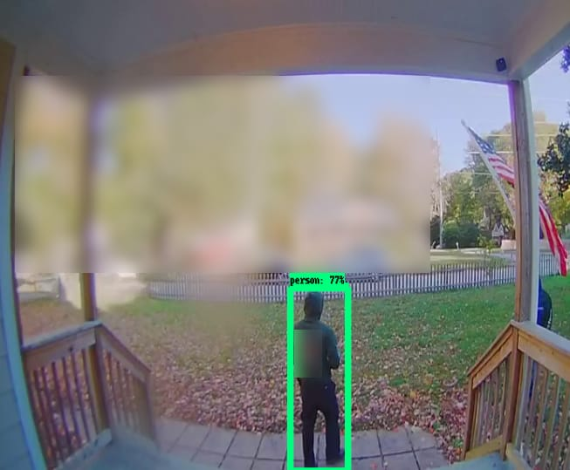
OBJECTIVE
In our country there is a lack of shortage for surveillance system due to high cost, to over come this shortage we came up with this technique.
The main goal is to detect both persons and objects for clear cut surveillance and ease for recognition of objects.
It also differentiate between both persons and animals, when a person is detected in the program shows green frame across the person.
If an animal is detected in the camera then red frame will come across the animals and the same with objects.

Slide 5
LITERATURE REVIEW
REVIEW 1:
TITLE : ”Transfer learning based object detection by using convolutional neutral networks.
AUTHORS NAME : Ms Bulbul Bamne, Ms Neha Shrivatava,
PUBLISHED ON : 2020 July.
METHOD USED : R-CNN,SSD
EXISTING TECHNOLOGY :It detects only the images. The fields like Artificial Intelligence, Speech recognition, face recognition.
ADVANTAGE : Easily captures and interprets the data.
FUTURE SCOPE : Bank Surveillance

Slide 6
REVIEW 2:
TITLE : ”Salient Object Detection ”
AUTHORS NAME : Ali Borji , Ming- Ming Cheng ,Huaizu Jiang and Jia Li.
PUBLISHED ON : December 2015.
METHOD USED :AAM Model, ECSSD, PASCAL-S AND DUT-OMRONEXISTING
EXISTING TECHNOLOGY: Salient object detection, saliency, explicit saliency, visual attention, regions of interest, object, segmentation, interestingness, importance, eye movements
ADVANTAGES : Ease of understanding.
FUTURE SCOPE : In Storage areas and lockers.

Slide 7
REVIEW 3:
TITLE : ”A review of object detection based on deep learning ”
AUTHORS NAME :Youzi xiao Zhiqiang Tian, Jiachen Yu, Yinshu Zhang Shuai Liu Shaoyi Du Xuguang Lan.
PUBLISHED ON : 2020.
METHOD USED :Low level and high level image features, DCNN..
EXISTING TECHNOLOGY :It is for logo detection, video detection, text detection, pedestrian detection, medical image detection.
ADVANTAGES : Easily detect objects.
FUTURE SCOPE :Very easy to produce the output.

Slide 8
EXISTING SYSTEM
The present surveillance system has poor object recognition ability and not much accurate and can be easily manipulated by some experts.
It cannot differentiate between persons and objects.
DISADVANTAGE:
Requires huge hardware.
Should monitor in person.
Low accuracy.
Low frame capture.

Slide 9
PROPOSED SYSTEM
In a video the images are extracted using the image processing techniques.
The training to identify the objects is done using deep learning.
The frames are extracted and the objects in each frame are identified using deep learning techniques.
ADVANTAGES:
Frame detection helps to identify clearly.
We can get images with the help of image processing.
Objects are detected with their names.

Slide 10
FLOW DIAGRAM
Training
Load model
Read frame from camera
Load Dataset
Preprocess frame from camera
Use the model to identify the objects
Name of the identified Object

Slide 11
MODULES
Dataset Loading:
dataset module is used to open Dataset classes and other subclasses and open images are used.
Training:
In this module the images are trained according to our requirement using mobile net SSD mode.
Load Model:
Here we load Mobile net SSD model to detect the images or objects from the video using frames.

Slide 12
MODULES
Read Frame:
In here, we read the images which are previously detected by camera using mobile net SSD model.
Pre process frame:
Frame objects are here processed according to the chosen set of parameters.

Slide 13
HARDWARE COMPONENTS
S NO. | NAME OF THE HARDWARE | NO. OF QUANTITY
1 | GPU | 1
2 | Laptop / Desktop | 1
3 | Camera | 1
4 | RAM | 4GB and above
5 | Mobile device | 1
SOFTWARE COMPONENTS
S NO. | NAME OF THE SOFTWARE
1 | Open CV, Numpy, Imultis
2 | Windows/Mac/Linux

Slide 14
REFERENCES
Bamne, B., Shrivastava, N., Parashar, L., & Singh, U. (2020, July). Transfer learning-based Object Detection by using Convolutional Neural Networks. In 2020 International Conference on Electronics and Sustainable Communication Systems (ICESC) (pp. 328-332). IEEE.
Zhao, Z. Q., Zheng, P., Xu, S. T., & Wu, X. (2019). Object detection with deep learning: A review. IEEE transactions on neural networks and learning systems, 30(11), 3212-3232.
Xiao, Y., Tian, Z., Yu, J., Zhang, Y., Liu, S., Du, S., & Lan, X. (2020). A review of object detection based on deep learning. Multimedia Tools and Applications, 79(33), 23729-23791.
Li, C., Zhang, Y., & Qu, Y. (2018, March). Object detection based on deep learning of small samples. In 2018 Tenth International Conference on Advanced Computational Intelligence (ICACI) (pp. 449-454). IEEE.

